Slide 1
EXCEPTION HANDLING

Slide 2
Exception
An exception is an abnormal condition that arises in a code sequence at run time.
An exception is a run time error

Slide 3
A Java exception is an object that describes an exceptional (that is, error) condition that has occurred in a piece of code
When an exceptional condition arises, an object representing that exception is created and thrown in the method that caused the error
That method maychoose to handle it self or pass it on.
At some point the exception is caught and processed

Slide 4
Exceptions can be generated by java run time system or can be manually generated by your code.
JRE generates exceptions when you violate the rules of java language or the constraints of java execution environment.
Manually generated exceptions are typically used to report some error condition to the caller of a method.

Slide 5
Java exception handling is managed via five keywords: try, catch, throw, throws, and finally
Program statements that you want to monitor for exceptions are contained within a try block
If an exception occurs within the try block, it is thrown
Your code can catch this exception (using catch) and handle it

Slide 6
System-generated exceptions are automatically thrown by the Java run-time system
To manually throw an exception, use the keyword throw
Any exception that is thrown out of a method must be specified as such by a throws clause
Any code that absolutely must be executed before a method returns is put in a finally block

Slide 7
This is the general form of an exception-handling block:
try {
// block of code to monitor for errors
}
catch (ExceptionType1 exOb) {
// exception handler for ExceptionType1
}
catch (ExceptionType2 exOb) {
// exception handler for ExceptionType2
}
// ...
finally {
// block of code to be executed before try block ends
}

Slide 8
Exception Types
All exception types are subclasses of the built-in class Throwable
Immediately below Throwable are two subclasses that partition exceptions into two distinct branches
One branch is headed by Exception
This class is used for exceptional conditions that user programs should catch

Slide 9
There is an important subclass of Exception, called RuntimeException
Exceptions of this type are automatically defined for the programs that you write and include things such as division by zero and invalid array indexing

Slide 10
The other branch is topped by Error, which defines exceptions that are not expected to be caught under normal circumstances by your program
Exceptions of type Error are used by the Java run-time system to indicate errors having to do with the run-time environment, itself
Stack overflow is an example of such an error

Slide 11
Uncaught Exceptions
class Exc0 {
public static void main(String args[]) {
int d = 0;
int a = 42 / d;
}
}
Java.lang.ArithmeticException: /by zero at Exc0.main(Exco.java:4)

Slide 12
When JRE detects the attempt to /0 it constrcucts a new exception object and throws this exception
This causes the execution of Exc0 to stop because once an exception is generated it should be caught some where.In this case we have not supplied any handler so default handler of JRE gets called.
Default handler displays string describing the exception and the stack trace from the point at which exception has occurred and terminates the program.

Slide 13
class Exc1 {
static void subroutine() {
int d = 0;
int a = 10 / d;
}
public static void main(String args[]) {
Exc1.subroutine();
}
}

Slide 14
Java.lang.ArithmeticException: /by zero
at Exc1.subroutine(Exc1.java:4)
at Exc1.main(Exc1.java:7)

Slide 15
Using try and catch
Handling an exception manually provides two benefits
First, it allows you to fix the error
Second, it prevents the program from automatically terminating

Slide 16
class Exc2 {
public static void main(String args[]) {
int d, a;
try { // monitor a block of code.
d = 0;
a = 42 / d;
System.out.println("This will not be printed.");
} catch (ArithmeticException e) { // catch divide-by-zero error
System.out.println("Division by zero.");
}
System.out.println("After catch statement.");
}
} o/p:
This program generates the following output:
Division by zero.
After catch statement.

Slide 17
A try and its catch statement form a unit
The scope of the catch clause is restricted to those statements specified by the immediately preceding try statement
A catch statement cannot catch an exception thrown by another try statement

Slide 18
// Handle an exception and move on.
import java.util.Random;
class HandleError {
public static void main(String args[]) {
int a=0, b=0, c=0;
Random r = new Random();
for(int i=0; i<32000; i++) {
try {
b = r.nextInt();
c = r.nextInt();
a = 12345 / (b/c);
} catch (ArithmeticException e) {
System.out.println("Division by zero.");
a = 0; // set a to zero and continue
}
System.out.println("a: " + a);
}
}
}

Slide 19
Displaying a Description of an Exception
catch (ArithmeticException e) {
System.out.println("Exception: " + e);
a = 0; // set a to zero and continue
}
Exception: java.lang.ArithmeticException: / by zero

Slide 20
Multiple catch Clauses
// Demonstrate multiple catch statements.
class MultiCatch {
public static void main(String args[]) {
try {
int a = args.length;
System.out.println("a = " + a);
int b = 42 / a;
int c[] = { 1 };
c[42] = 99;
} catch(ArithmeticException e) {
System.out.println("Divide by 0: " + e);
} catch(ArrayIndexOutOfBoundsException e) {
System.out.println("Array index oob: " + e);
}
System.out.println("After try/catch blocks.");
}
}

Slide 21
Java MultiCatch
a=0
Divide by 0:java.lang.ArithmeticException:/by zero
After try/catch blocks
        OR
Java MultiCatch TestArg
a=1
Array index oob:java.lang.ArrayIndexOutOfBoundsException:42
After try/catch blocks

Slide 22
/* This program contains an error. A subclass must come before its superclass in a series of catch statements. If not, unreachable code will be created and a compile-time error will result. */
class SuperSubCatch {
public static void main(String args[]) {
try {
int a = 0;
int b = 42 / a;
} catch(Exception e) {
System.out.println("Generic Exception catch.");
}
/* This catch is never reached because ArithmeticException is a subclass of Exception. */
catch(ArithmeticException e) { // ERROR - unreachable
System.out.println("This is never reached.");
}
}
}

Slide 23
Nested try Statements
Each time a try statement is entered, the context of that exception is pushed on the stack

Slide 24
// An example nested try statements.
class NestTry {
public static void main(String args[]) {
try {
int a = args.length;
/* If no command line args are present,
the following statement will generate
a divide-by-zero exception. */
int b = 42 / a;
System.out.println("a = " + a);
try { // nested try block
/* If one command line arg is used,
then an divide-by-zero exception
will be generated by the following code. */

Slide 25
if(a==1) a = a/(a-a); // division by zero
/* If two command line args are used
then generate an out-of-bounds exception. */
if(a==2) {
int c[] = { 1 };
c[42] = 99; // generate an out-of-bounds exception
}
} catch(ArrayIndexOutOfBoundsException e) {
System.out.println("Array index out-of-bounds: " + e);
}
} catch(ArithmeticException e) {
System.out.println("Divide by 0: " + e);
}
}
}

Slide 26
/* Try statements can be implicitly nested via
calls to methods. */
class MethNestTry {
static void nesttry(int a) {
try { // nested try block
/* If one command line arg is used,
then an divide-by-zero exception
will be generated by the following code. */
if(a==1) a = a/(a-a); // division by zero
/* If two command line args are used
then generate an out-of-bounds exception. */
if(a==2) {
int c[] = { 1 };
c[42] = 99; // generate an out-of-bounds exception
}
} catch(ArrayIndexOutOfBoundsException e) {

Slide 27
System.out.println("Array index out-of-bounds: " + e);
}
}
public static void main(String args[]) {
try {
int a = args.length;
/* If no command line args are present,
the following statement will generate
a divide-by-zero exception. */
int b = 42 / a;
System.out.println("a = " + a);
nesttry(a);
} catch(ArithmeticException e) {
System.out.println("Divide by 0: " + e);
}
}
}

Slide 28
throw
It is possible for your program to throw an exception explicitly, using the throw statement
The general form of throw is shown here:
throw ThrowableInstance;

Slide 29
Here, ThrowableInstance must be an object of type Throwable or a subclass of Throwable
There are two ways you can obtain a Throwable object: using a parameter into a catch clause, or creating one with the new operator
The flow of execution stops immediately after the throw statement; any subsequent statements are not executed

Slide 30
// Demonstrate throw.
class ThrowDemo {
static void demoproc() {
try {
throw new NullPointerException("demo");
} catch(NullPointerException e) {
System.out.println("Caught inside demoproc.");
throw e; // rethrow the exception
}
}
public static void main(String args[]) {
try {
demoproc();
} catch(NullPointerException e) {
System.out.println("Recaught: " + e);
} } }
Output:
Caught inside demoproc.
Recaught: java.lang.NullPointerException: demo

Slide 31
throws
If a method is capable of causing an exception that it does not handle, it must specify this behavior so that callers of the method can guard themselves against that exception
A throws clause lists the types of exceptions that a method might throw

Slide 32
Exceptions that a method can throw must be declared in the throws clause
This is the general form of a method declaration that includes a throws clause:
type method-name(parameter-list) throws exception-list
{
// body of method
}
Here, exception-list is a comma-separated list of the exceptions that a method can throw

Slide 33
// This program contains an error and will not compile.
class ThrowsDemo {
static void throwOne() {
System.out.println("Inside throwOne.");
throw new IllegalAccessException("demo");
}
public static void main(String args[ ]) {
throwOne();
}
}

Slide 34
class ThrowsDemo {
static void throwOne() throws IllegalAccessException {
System.out.println("Inside throwOne.");
throw new IllegalAccessException("demo");
}
public static void main(String args[]) {
try {
throwOne();
} catch (IllegalAccessException e) {
System.out.println("Caught " + e);
}
}
}
Here is the output generated by running this example program:
inside throwOne
caught java.lang.IllegalAccessException: demo

Slide 35
finally
finally creates a block of code that will be executed after a try/catch block has completed and before the code following the try/catch block
The finally block will execute whether or not an exception is thrown
If an exception is thrown, the finally block will execute even if no catch statement matches the exception

Slide 36
The finally clause is optional
Each try statement requires at least one catch or a finally clause

Slide 37
// Demonstrate finally.
class FinallyDemo {
// Through an exception out of the method.
static void procA() {
try {
System.out.println("inside procA");
throw new RuntimeException("demo");
} finally {
System.out.println("procA's finally");
}
}
// Return from within a try block.
static void procB() {
try {
System.out.println("inside procB");
return;
} finally {
System.out.println("procB's finally");
}
}

Slide 38
// Execute a try block normally.
static void procC() {
try {
System.out.println("inside procC");
} finally {
System.out.println("procC's finally");
}
}
public static void main(String args[]) {
try {
procA();
} catch (Exception e) {
System.out.println("Exception caught");
}
procB();
procC();
}
}

Slide 39
Here is the output generated by the preceding program:
inside procA
procA’s finally
Exception caught
inside procB
procB’s finally
inside procC
procC’s finally

Slide 40
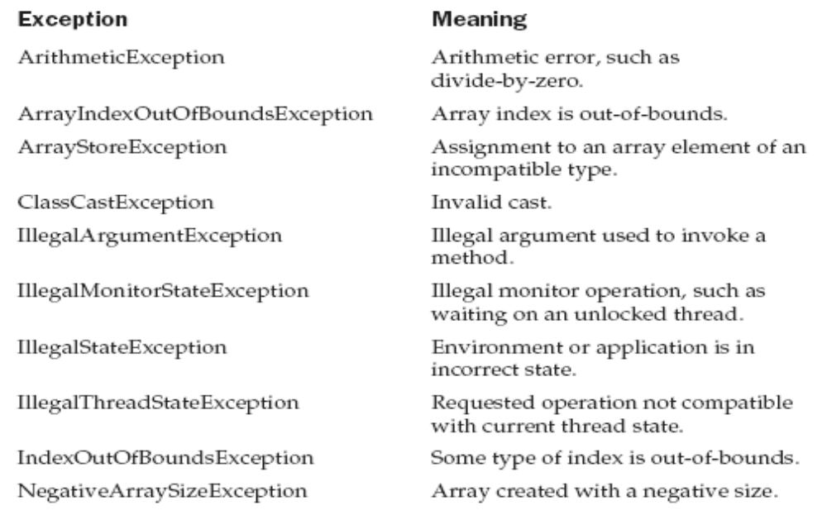
Java’s Built-in Exceptions

Slide 41
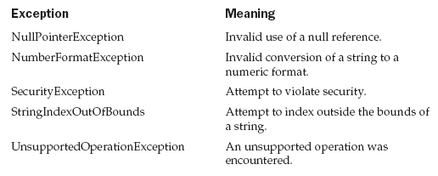

Slide 42
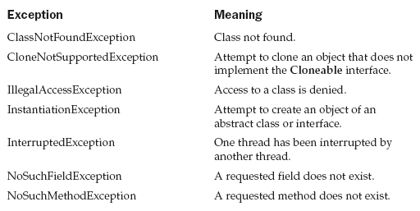

Slide 43
Creating our own Exception subclasses
// This program creates a custom exception type.
class MyException extends Exception {
private int detail;
MyException(int a) {
detail = a;
}
public String toString() {
return "MyException[" + detail + "]";
}
}
class ExceptionDemo {
static void compute(int a) throws MyException {
System.out.println("Called compute(" + a + ")");

Slide 44
Creating our own Exception subclasses
if(a > 10)
throw new MyException(a);
System.out.println("Normal exit");
}
public static void main(String args[]) {
try {
compute(1);
compute(20);
} catch (MyException e) {
System.out.println("Caught " + e);
}
}
}

Slide 45
Called compute(1)
Normal exit
Called compute(20)
Caught MyException[20]

